Slide 1
INFORMATION AND COMMUNICATION TECHNOLOGIES
GROUP 1 PRESENTATION

Slide 2

INTRODUCTION TO INFORMATION AND COMMUNITIES TECHNOLOGIES (ICT)

Slide 3
At the end of this lesson, you should be able to:
Compare and contrast the nuances of varied online platforms, sites, and content to best achieve specific class objectives or address situational challenges

Slide 4
INFORMATION AND COMMUNICATION TECHNOLOGIES (ICT)
It refers to the use of communication technology such as laptop, smart phone, tablet, telephone, internet and etc. to send, save and edit information.

Slide 5
ICT IN THE PHILIPPINES
“ICT HUB OF PHILIPPINES”

Slide 6

It is also known as WWW or W3 introduce by Tim Berners-Lee. It consists of different pages that are formatted in a markup language called HTML (Hypertext Markup Language) and linked to each other that contain text, graphics, multimedia
files, hyperlinks and etc.
WORLD
WIDE
WEB

Slide 7

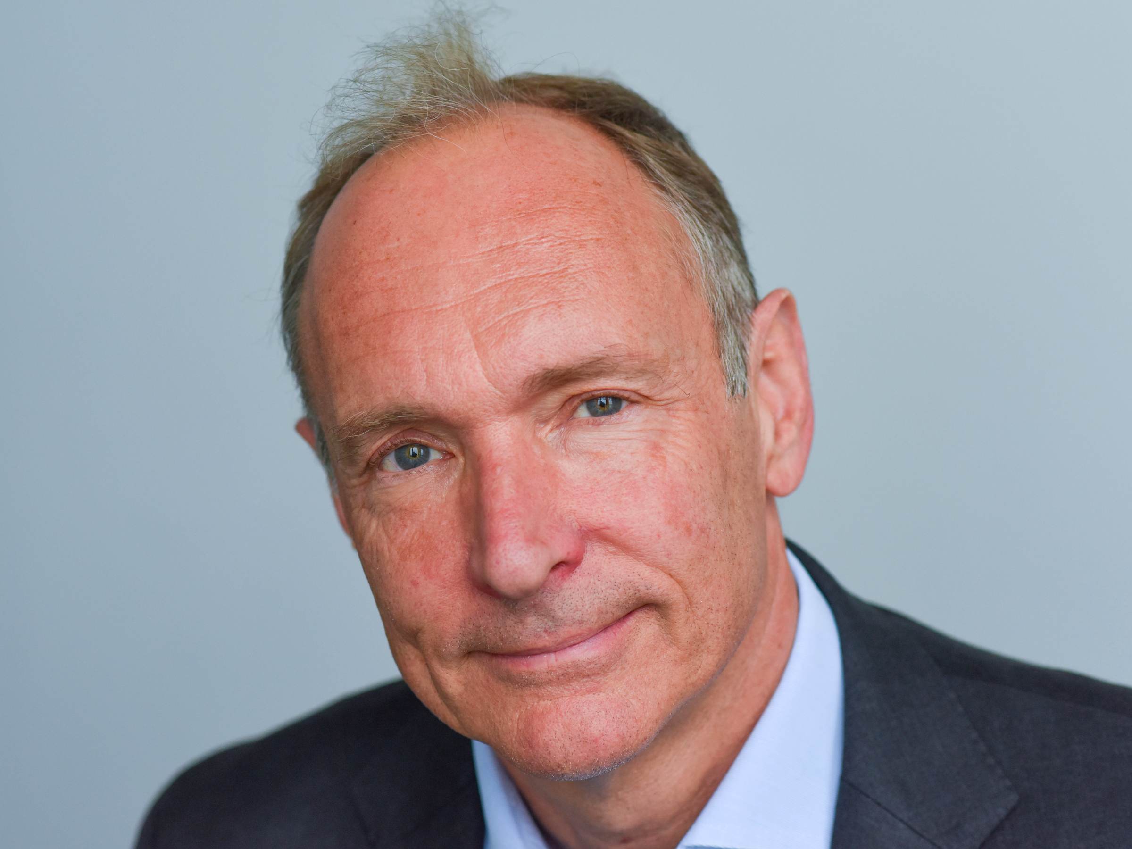

TIM BERNERS-LEE

Slide 8
WEB 1.0
The first development of World Wide Web where web pages are static. It is also known as flat or stationary page and it cannot be manipulated by users.

Slide 9
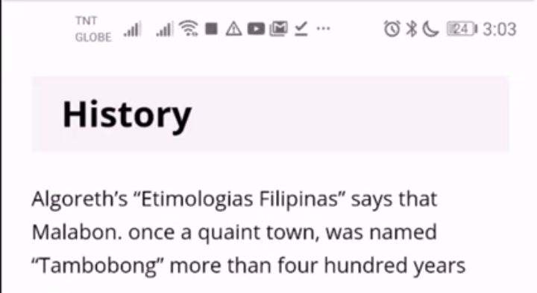
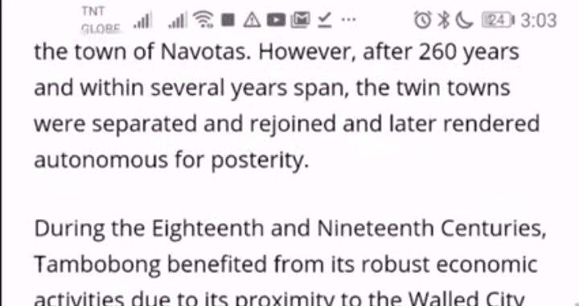

Slide 10

WEB 2.0
Dynamic webpage
Users can interact with the sites and with other user
Can see webpage differently from others

Slide 11
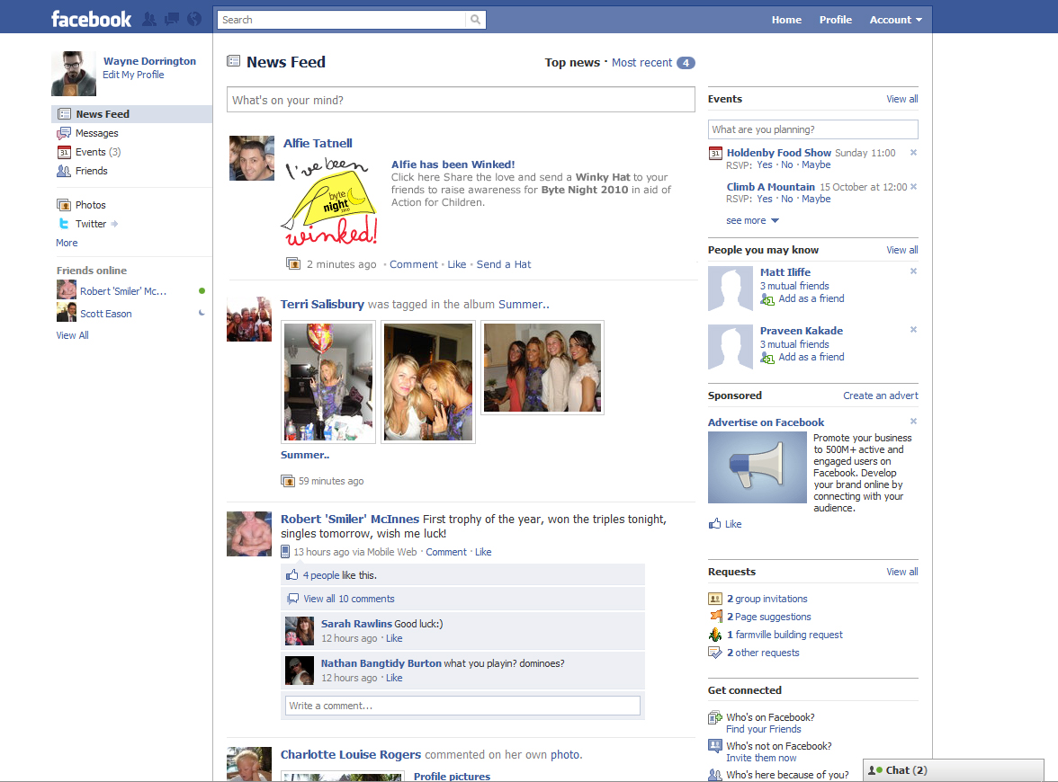
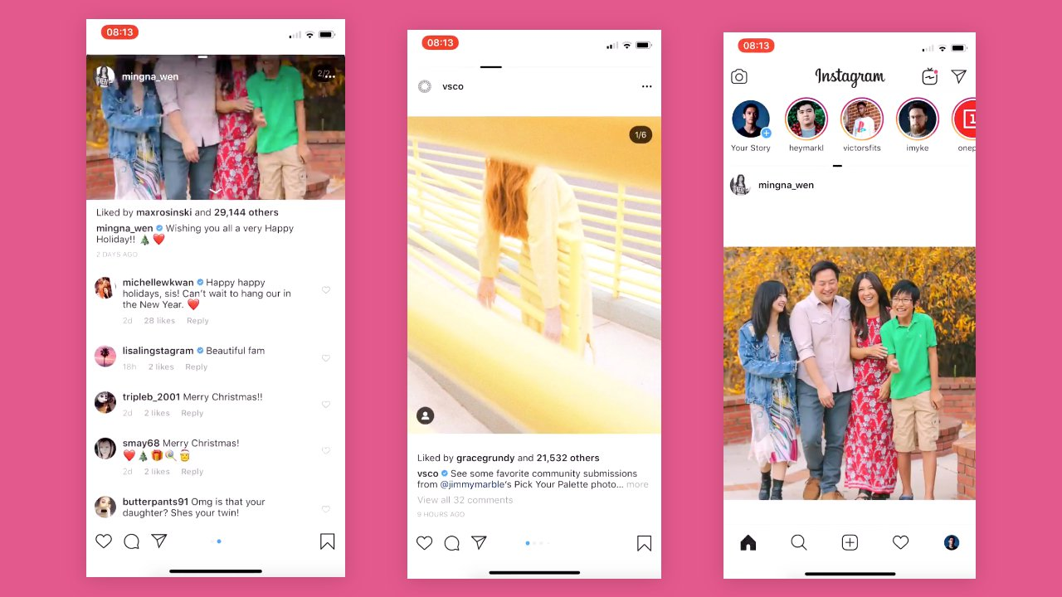

Slide 12
FEATURES OF WEB 2.0

Slide 13
FOLKSONOMY
01
-users can classify and arrange information by adding tag or
label. Pound sign (#) is used in Facebook, Twitter, Instagram and other social networking sites.

Slide 14
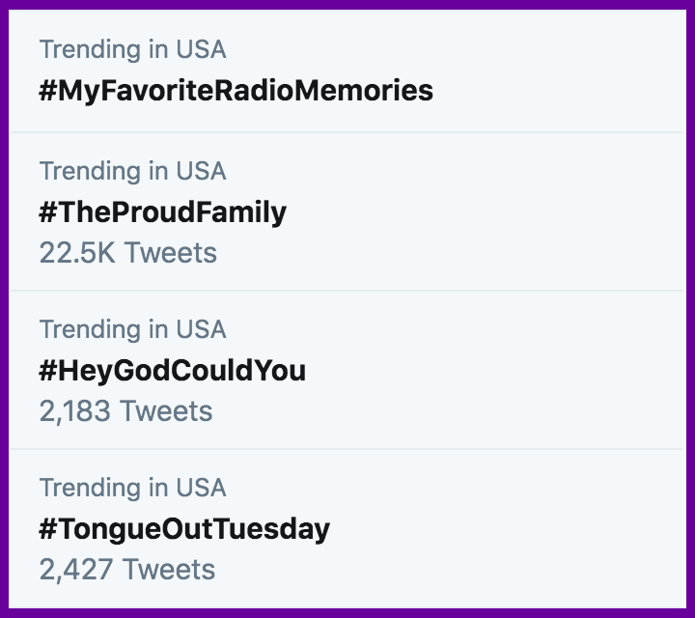


Slide 15

RICH USER EXPERIENCE
02
-user can have high interaction with the content of the
page and can achieve level of expertise.

Slide 16
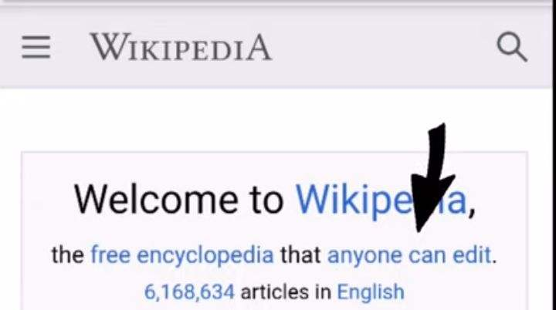

Slide 17

USER PARTICIPATION
03
-user can put content on their own in web page like comment, review, evaluation, and etc.

Slide 18
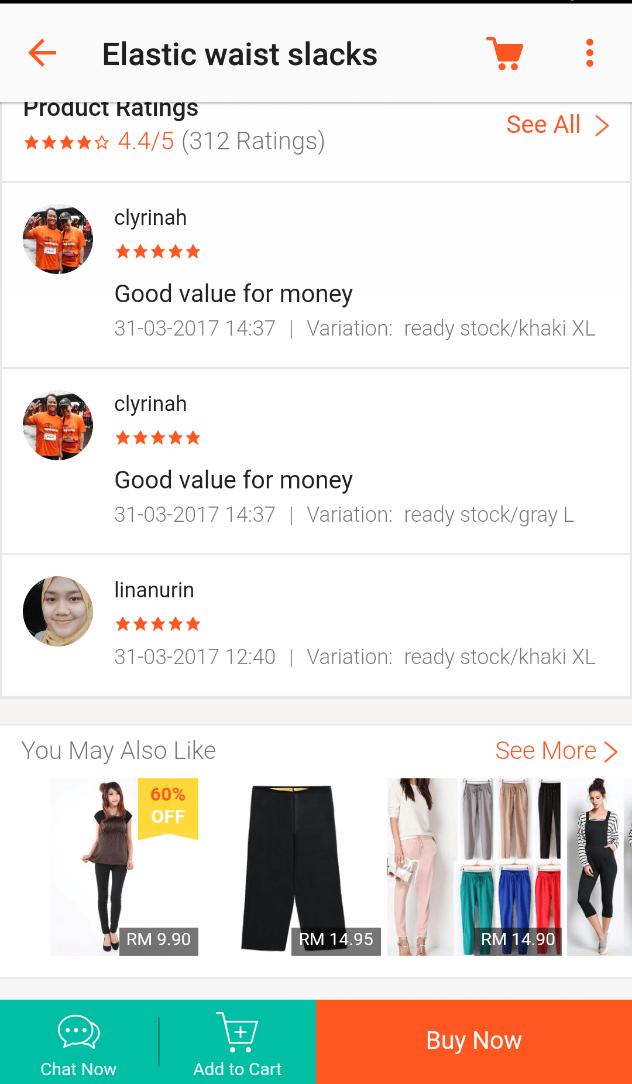
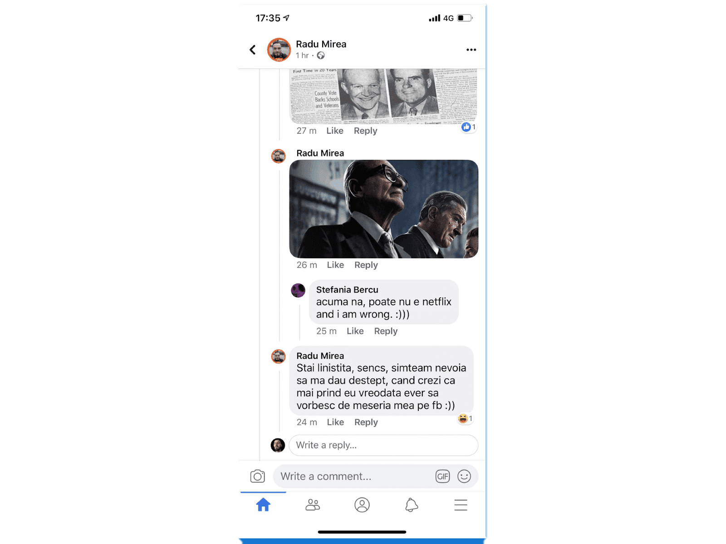

Slide 19

LONG TAIL
04
-services are offered on demand rather than on a one-time purchase.

Slide 20
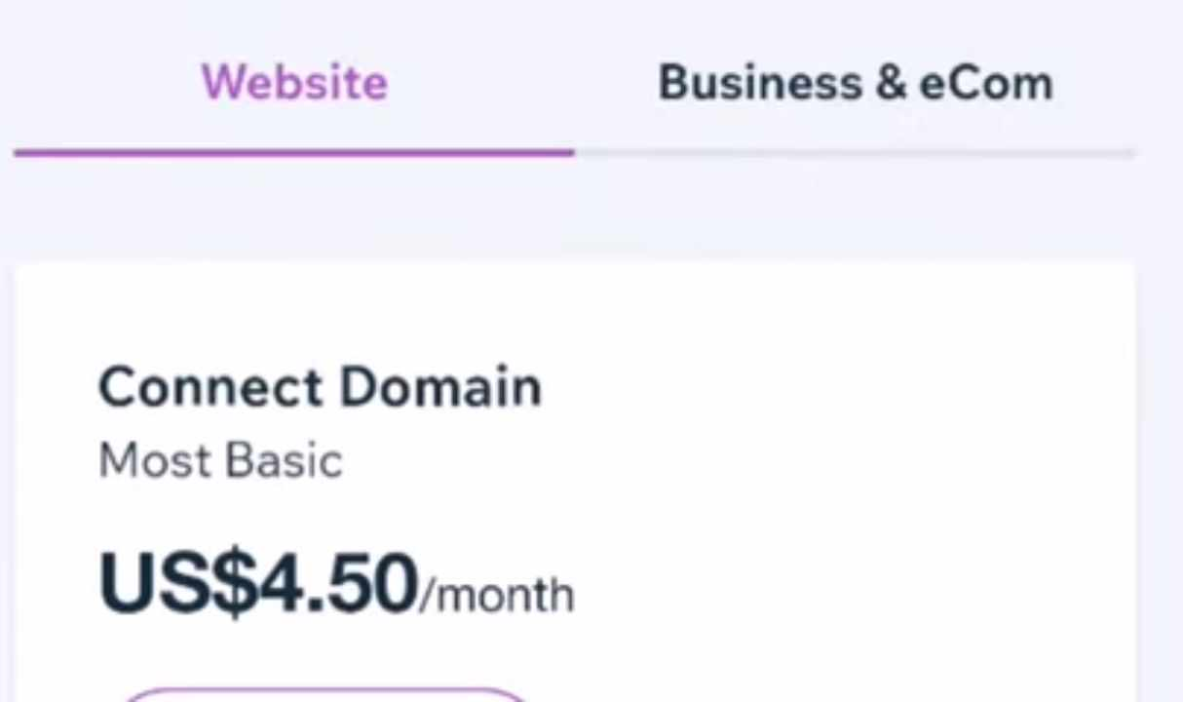

Slide 21

SOFTWARE AS A SERVICE
05
-users can subscribe to a software when they need it instead of purchasing them.

Slide 22
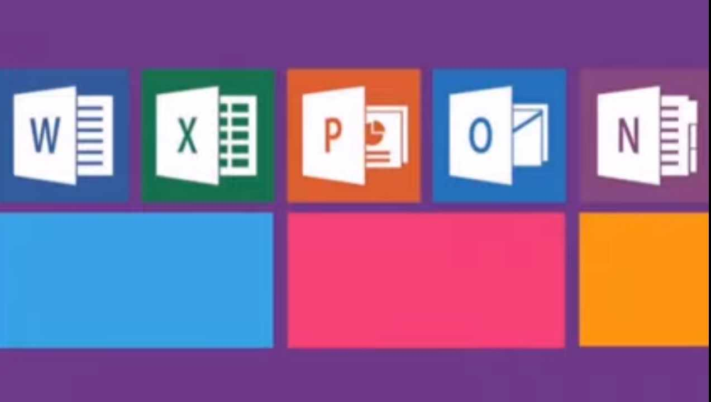

Slide 23

MASS PARTICIPATION
06
-sharing of diverse information through universal web access.

Slide 24

WEB 3.0
The Semantic Web
A new paradigm in web interaction extension of led by World Wide Web Consortium (W3C) where it provides framework that allows data to be shared and reuse.

Slide 25
Several problems of Web 3.0
01
02
03
Compatibility
Security
Vastness
-HTML files and current web browsers could not support Web 3.0.
-The World Wide Web already contains billions of web pages.
-The user’s security is also in question since the machine is saving his or her preferences.

Slide 26




Several problems of Web 3.0
04
05
Vagueness
Logic
-Certain words are imprecise. The words “old” and “small” would depend on the user.
-Since machines use logic, there are certain limitations for a computer to be able to predict what the user is referring to at a given time.

Slide 27
TRENDS IN ICT
4,498,300

Slide 28
CONVERGENCE
01
It refers to fusing of technological advancement to work on a similar task.

Slide 29
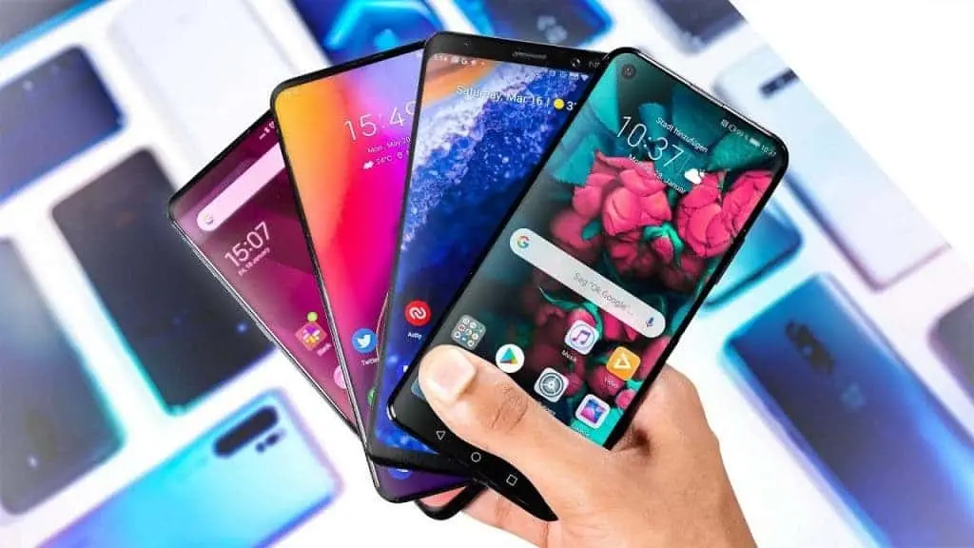


Slide 30


SOCIAL MEDIA
02
An application and website where user can communicate, create and share contents, and participate in online communities.

Slide 31
TYPES OF SOCIAL MEDIA

Slide 32
01
SOCIAL NETWORK
– A website where people with the same come together to share information.
Examples: Facebook, Instagram, Twitter

Slide 33

02
SOCIAL NEWS
– A website where user can post stories and are
ranked based on the popularity through voting.
Examples: Digg, Reddit, Propeller, Slashdot

Slide 34
03
BOOKMARKING SITES
-A website that allows you to share and store internet bookmarks, articles, posts, blogs, images and others.
Example: Pinterest

Slide 35
04
MEDIA SHARING
-A website that allows you to share and store multimedia files such as video, photos and music.
Examples: Instagram, YouTube

Slide 36
05
MICRO- BLOGGING
– a website that allows you to broadcast short
message.
Examples: Twitter, Tumblr

Slide 37
06
BLOGS AND FORUMS
– a discussion website that allows user to ask questions and comments on a journal posted by an individual or group. Examples: Wordpress, Blogger

Slide 38
MOBILE TECHNOLOGIES
03
– a technology used in cellular and other devices such
netbook, laptop, tablet, smartphones and etc.

Slide 39
KINDS OF OPERATING SYSTEM
Android
Blackberry
OS
iOS
Symbian
WebOS

Slide 40
ASSISTIVE MEDIA
04
- A platform that assist people with disability. It will guide the
individual like a blind person by using an audio recording.

Slide 41
THANK YOU FOR LISTENING

